Slide 1
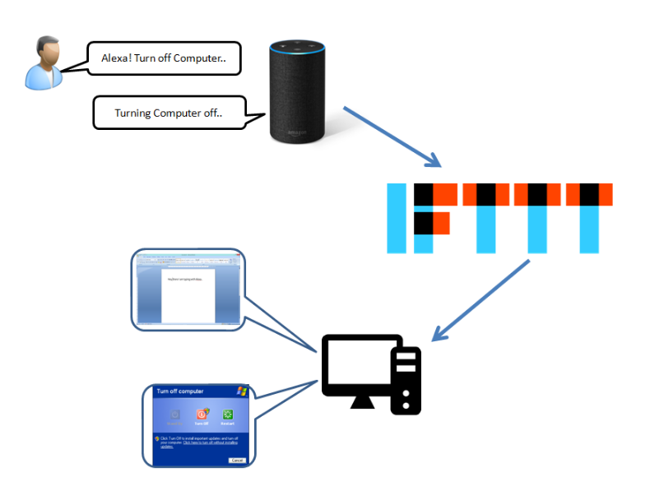
Control your PC
Special topics in Advanced Networks with Dr. Y. Liu
Shah Chirag Hareshkumar (1001558824)
Idris Wishiwala (1001538840)
Toor Shubhpreet Singh (1001564975)

Slide 2
Motivation
Less infrastructure cost
Automation
Realtime notifications and analysis

Slide 3
Project Setup
Software's:
Applets:
IFTTT
PushBullet
Tasker
DialogFlow
Languages:
Php and Python
Hardware:
DELL Laptop
Apple MAC Book Pro
HP Laptop

Slide 4
Implementation
IFTTT and Pushbullet:
General computer operations with backend PHP scripts (e.g. open word, type in word, sleep)
Tasker:
Wake up Computer on LAN
Dialogflow:
Customized interactions to perform computer operations with backend Python script
Control multiple PCs

Slide 5
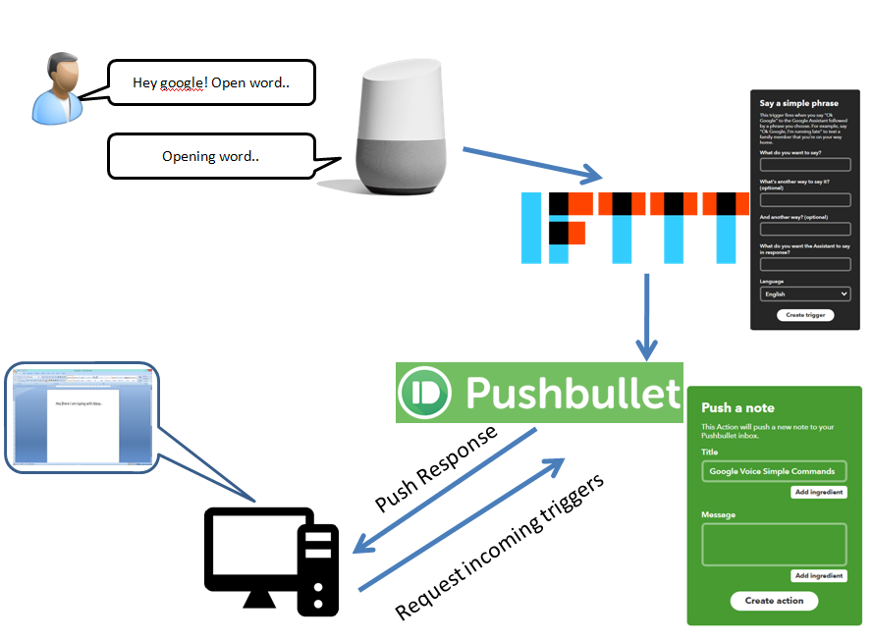
IFTTT and Pushbullet
Running PHP script

Slide 6
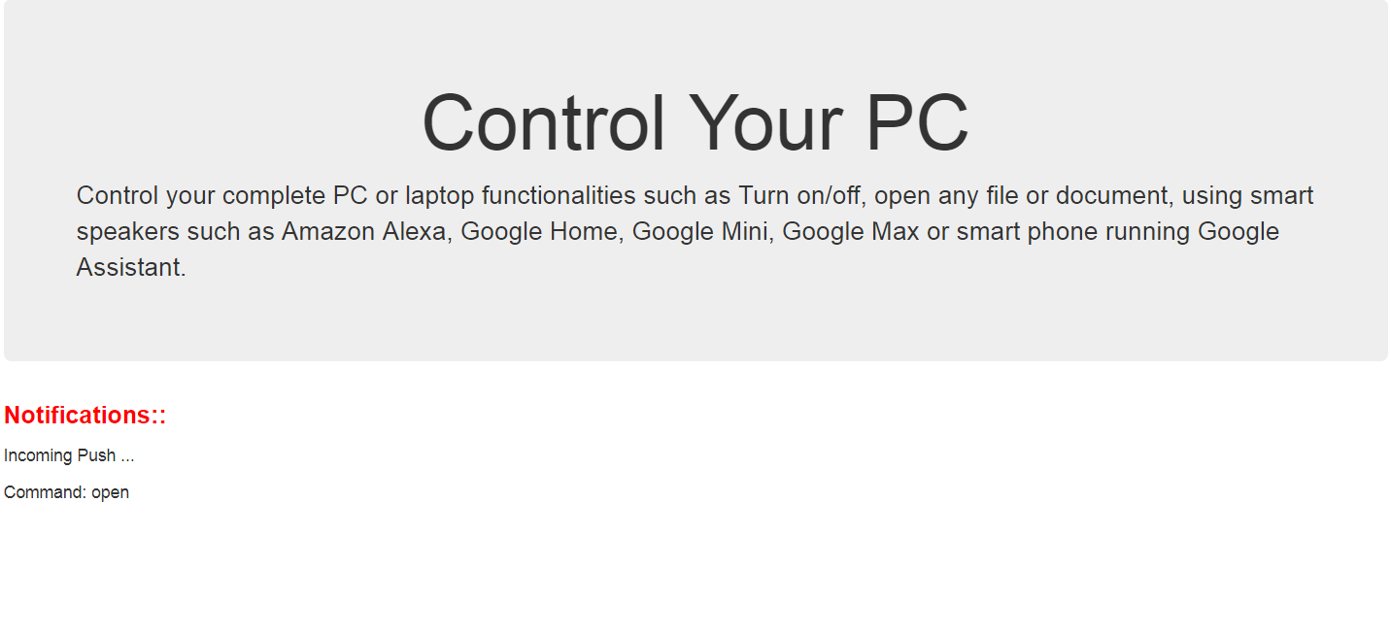
A Web App Approach..

Slide 7
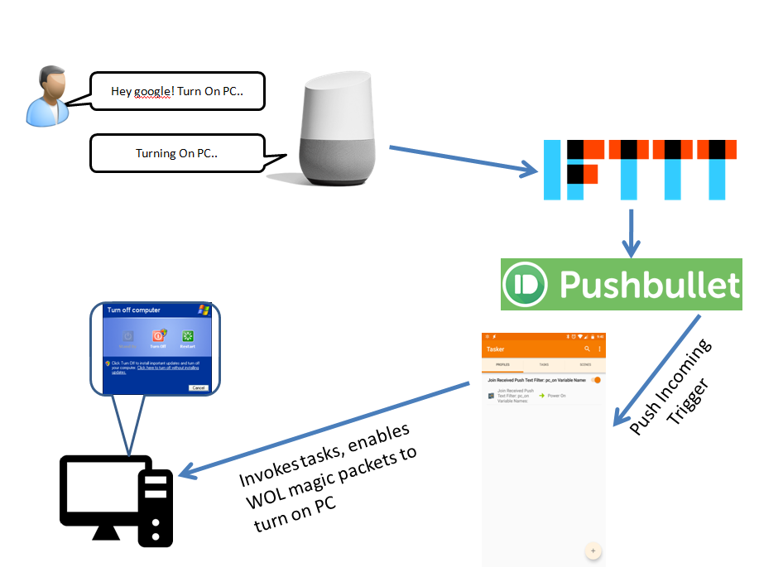
Tasker

Slide 8
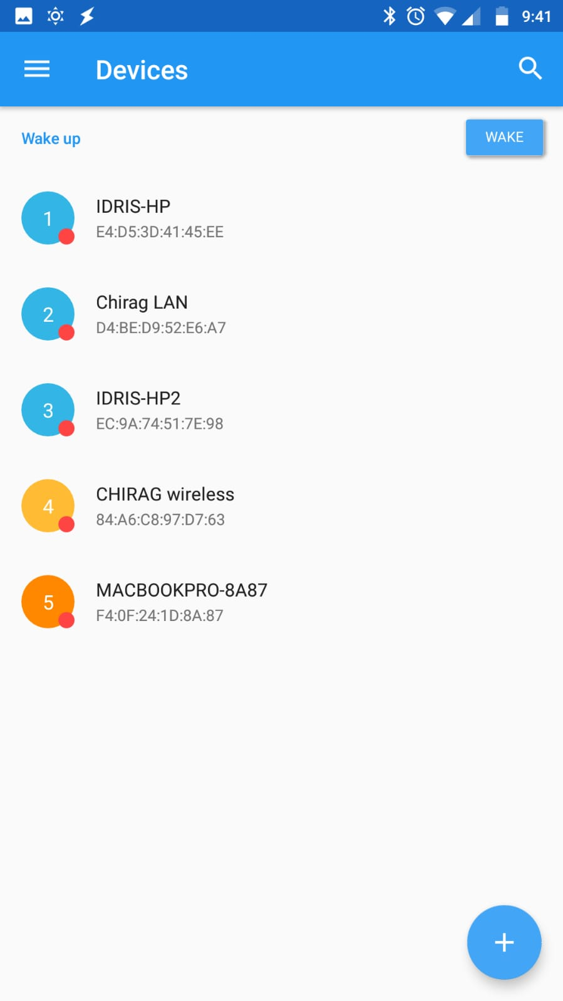
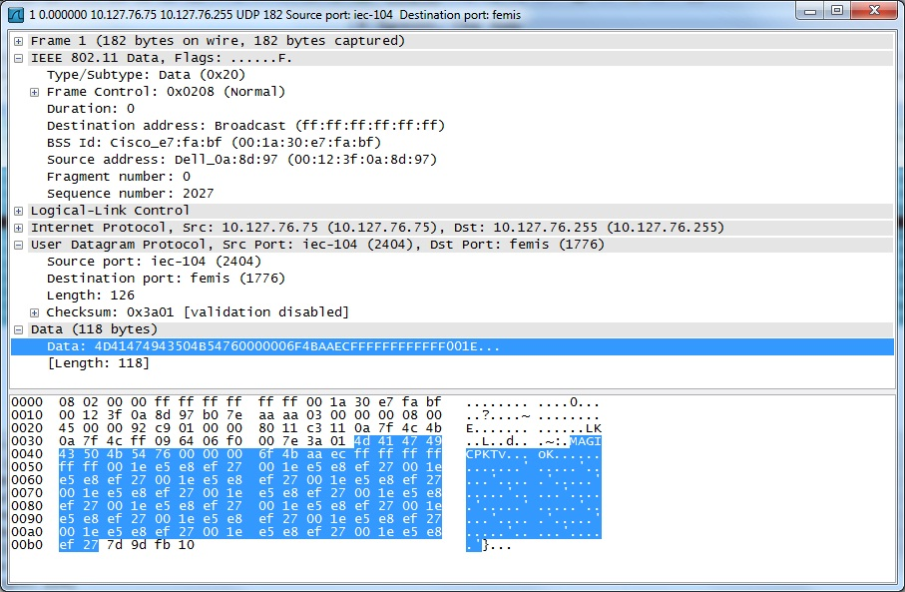
Wake on LAN

Slide 9
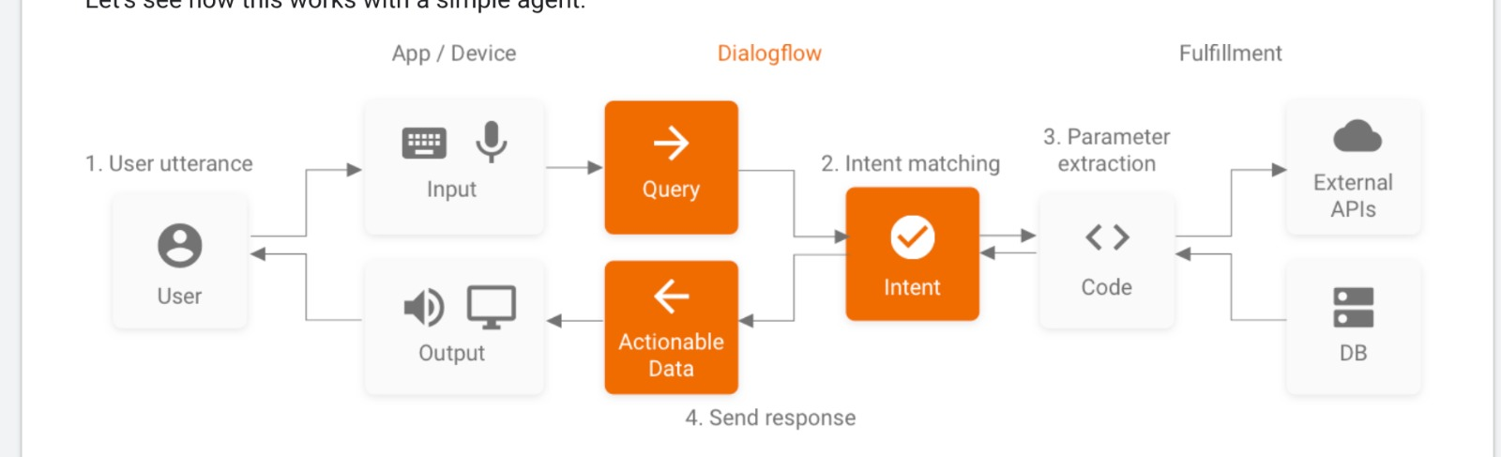
Dialogflow

Slide 10
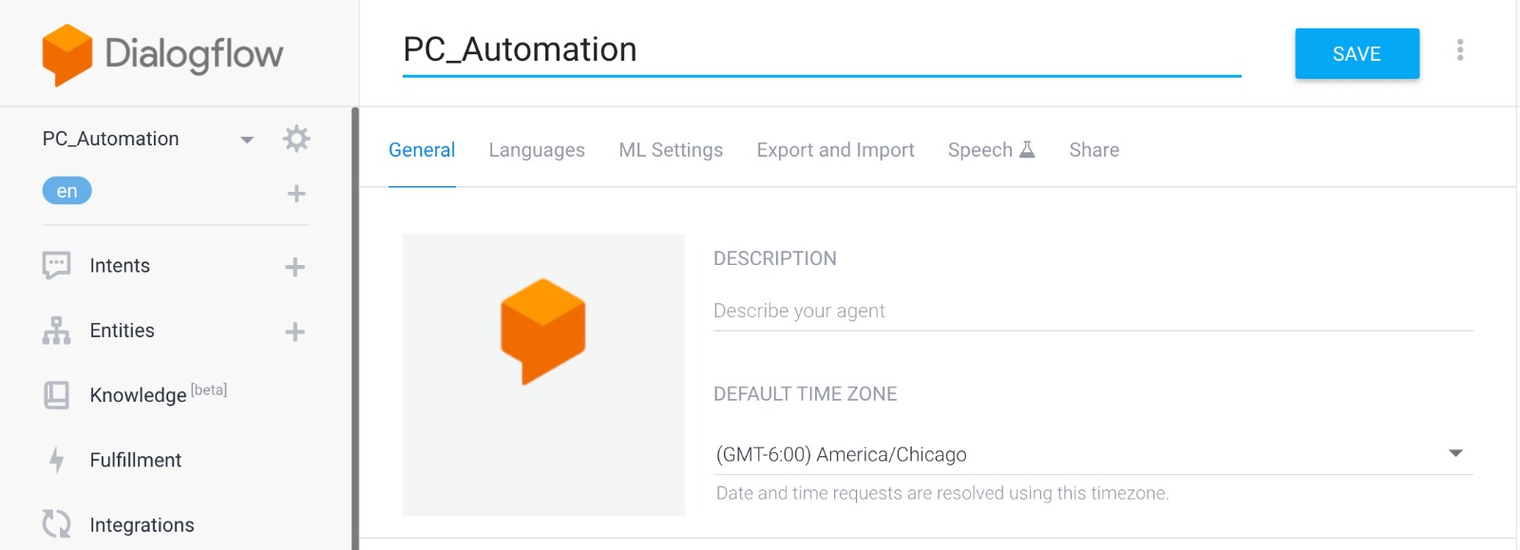
PC Automation

Slide 11

Academic Advisor

Slide 12
Difficulties
IFTTT with Alexa has not options to give parameters
Turning system on using WOL wireless has issues
Turning system on requires pre-hand configurations

Slide 13
Future Work & Enhancements
Seamless realtime Computer/Device operations
Secure Turning On/Off Computers wirelessly
Connecting Database with Dialogflow
Connecting applications with Dialogflow
Smoother NLP functionalities

Slide 14
Questions?
- Thank you.

